Slide 1
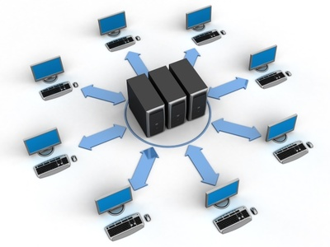
Computer Network
Network fundamentals part 1

Slide 2
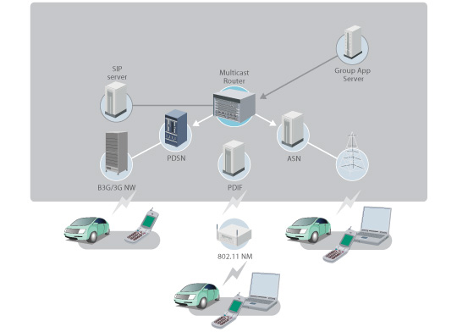
Objectives:
After completion of this lecture, you will be able to answer the following questions:
What is the purpose of a network?
What are some examples of network components?
How are networks defined by geography?
How are networks defined by topology?
How are networks defined by resource location?.

Slide 3
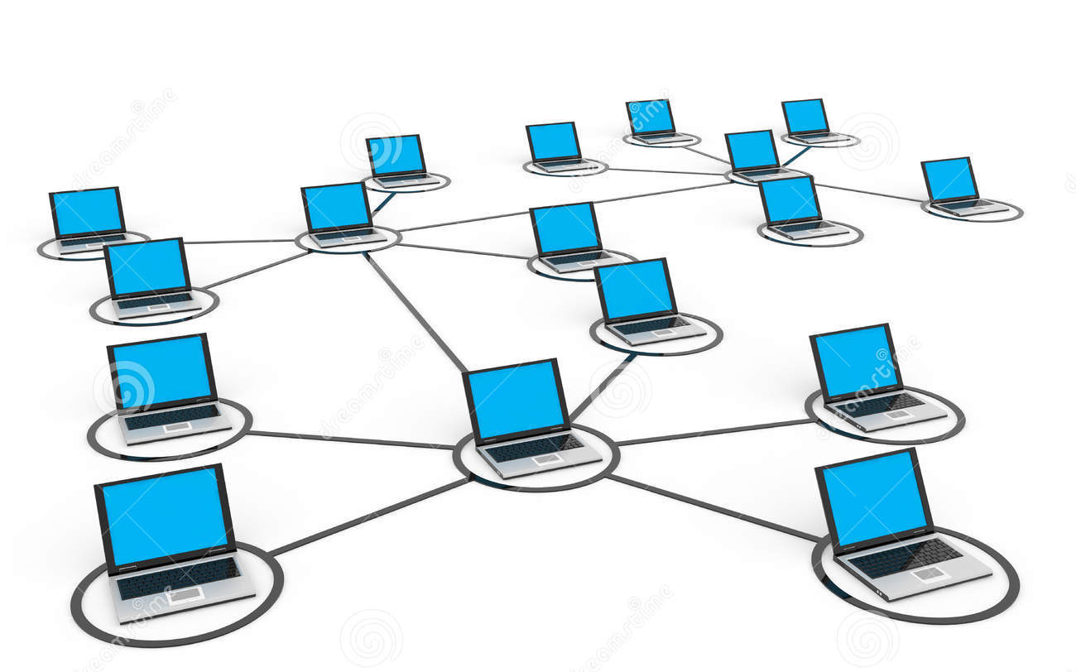
What is the purpose of a network?
File sharing between two computers.
Video chatting between computers located in different parts of the world.
Surfing the Web (for example, to use social media sites, watch streaming video, listen to an Internet radio station, or do research for a school term paper).
Instant messaging (IM) between computers with IM software installed.
Email.
Voice over IP (VoIP), to replace traditional telephony systems.

Slide 4
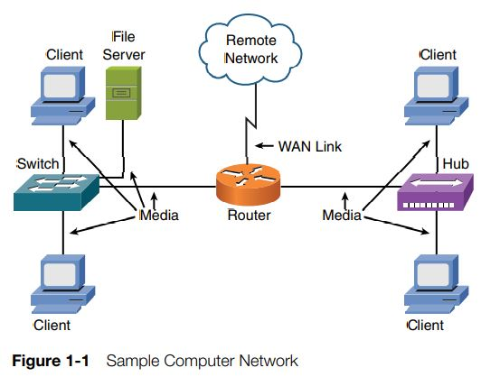
What are some examples of network components?
The components to consider for now are the client, server, hub, switch, router, media, and wide area network (WAN) link. As a reference for this discussion, consider Figure 1-1.

Slide 5
How are networks defined by geography?
LAN
CAN
MAN
WAN

Slide 6
Network design Classification:
LAN
Some PCs that are linked together with a switch.
CAN
It consists of some LANs that are connected together.
MAN
It consists of some CANs that are connected together.
Geographically it’s the network implemented in the government.
Geographically it’s the network implemented in a small office or building
Geographically it’s the network implemented in a university.
WAN
It consists of some MANs that are connected together.

Slide 7
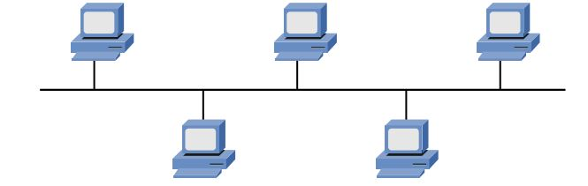
An overview over network topologies:
Bus
Ring
Star
Mesh
Hybrid

Slide 8
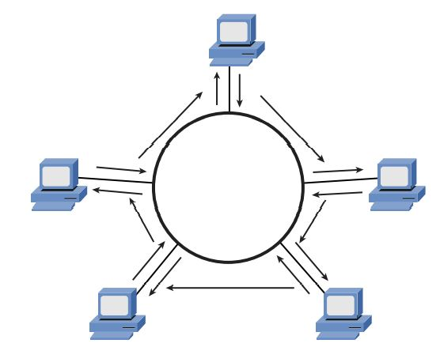
Ring Topology

Slide 9
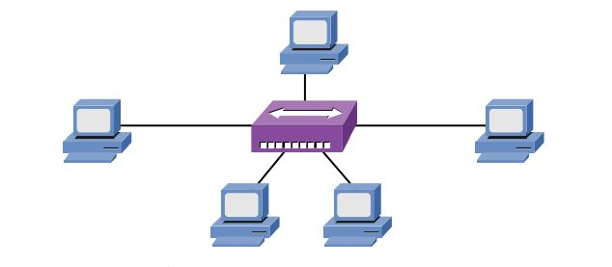
Star Topology

Slide 10
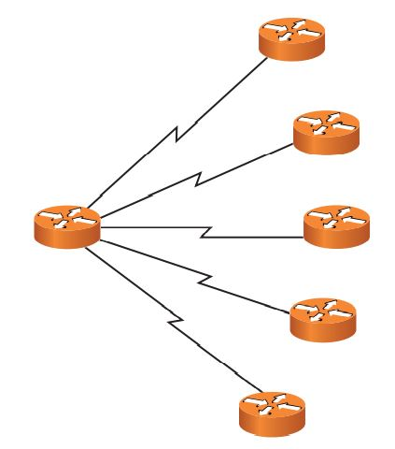
Hub and Spoke

Slide 11
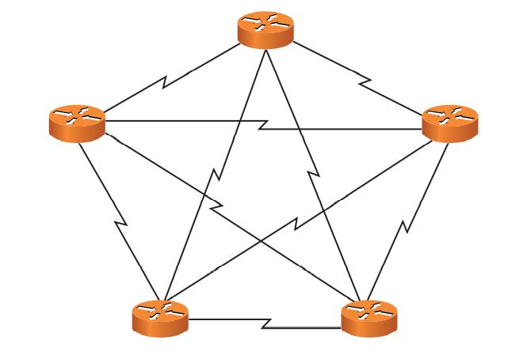
Mesh Topology

Slide 12
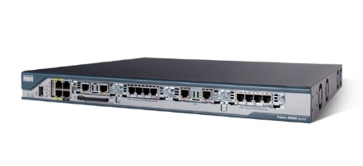
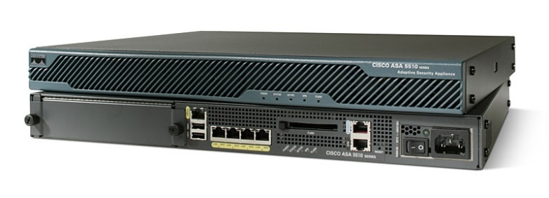
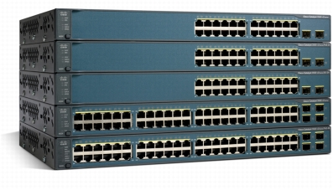
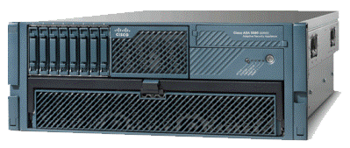
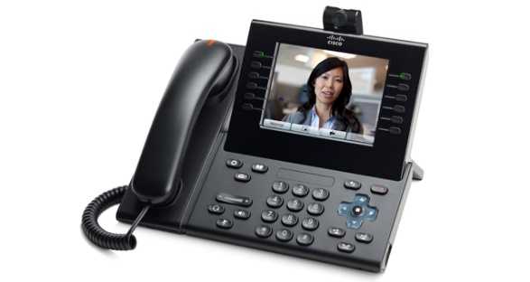
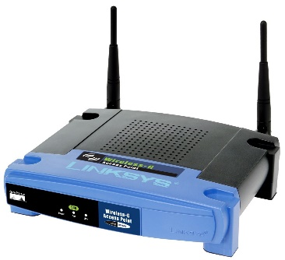
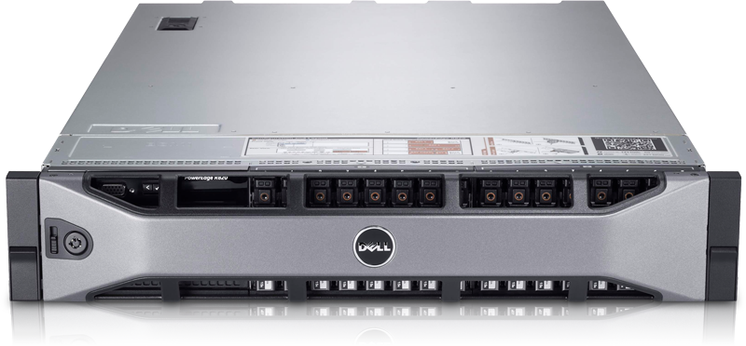
Network devices and their applications:
Switch
Router
IPS/IDS
Server
IP-Phone
Access Point
Firewall

Slide 13
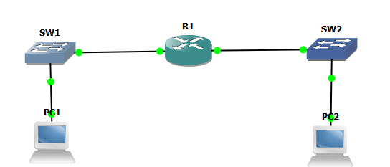
Network devices and their applications:
Some switch’s functions:
1-Connecting PCs together to create a LAN.
2-Connecting other devices than PCs, as IP-Cameras, IP-Phones and more.
C3750
LAN-1
LAN-2

Slide 14
Network devices and their applications:
Some router’s functions:
1-Connecting LANs together.
2-Connecting your entire network to the internet.
2-Multifunctional device as It can operate as a firewall, switch, IPS/IDS, unified communication server and more.
C2801
LAN-1
LAN-2

Slide 15
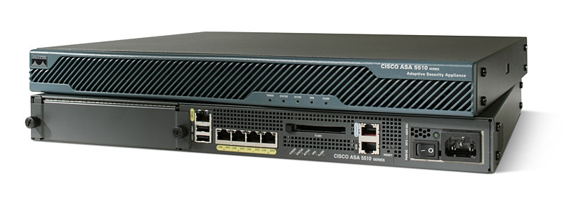
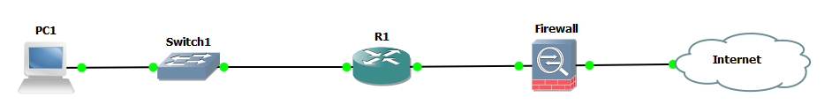
Network devices and their applications:
Some firewall’s functions:
1-Filtering packets coming in/out the network.
2-Controlling authentication/authorization of the network users.
3-In common designs, it’s configured to be in face of the internet.
CISCO ASA 5510
Inside
Outside

Slide 16
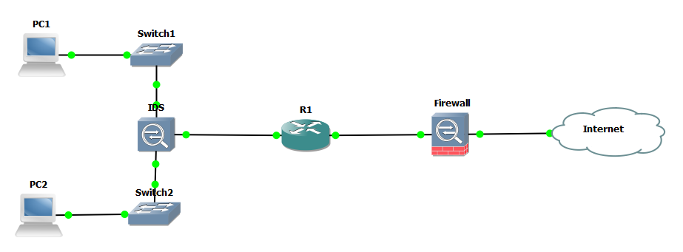
Network devices and their applications:
Some IPS/IDS’s functions:
1-Working on monitoring packets moving between PCs in the entire network.
2-IDS stands for “Intrusion Detection System”, and it scans the network for detecting attacks but it doesn’t stop them.
3-IPS stands for “Intrusion Prevention System”, it scans the network for detecting attacks and also stops them.
CISCO IP 4270

Slide 17

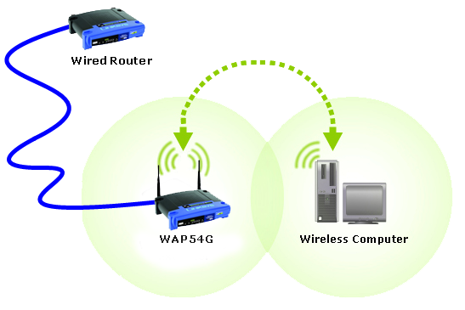
Network devices and their applications:
Some access point’s functions:
1-It has the same switch’s functions, but it connects PCs together wirelessly.
2-Why it’s considered to be a matter of danger.
CISCO LINKSYS

Slide 18
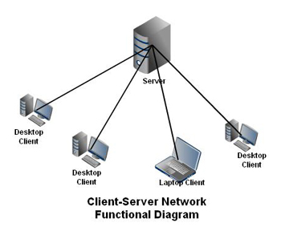
Network devices and their applications:
Some server's functions:
1-The server works as a supplier for PCs whether they’re on the same LAN or across WAN, for many services, like to be a web, mail, dhcp server and more.
2-Cisco has recently started the servers industry with its UCS series.
DELL POWEREDGE R620

Slide 19

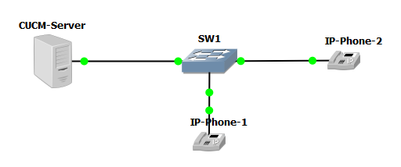
Network devices and their applications:
Some IP phone’s functions:
1-Works with the great VOIP “voice over IP” technology.
2-Used a lot in companies, banks and schools.
CISCO IP-Phone 9900

Slide 20
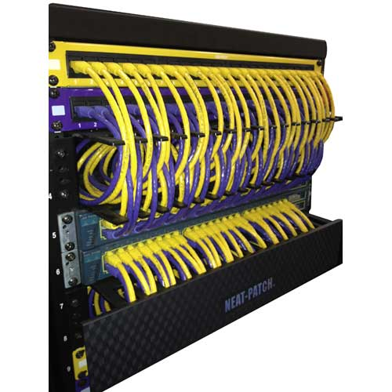
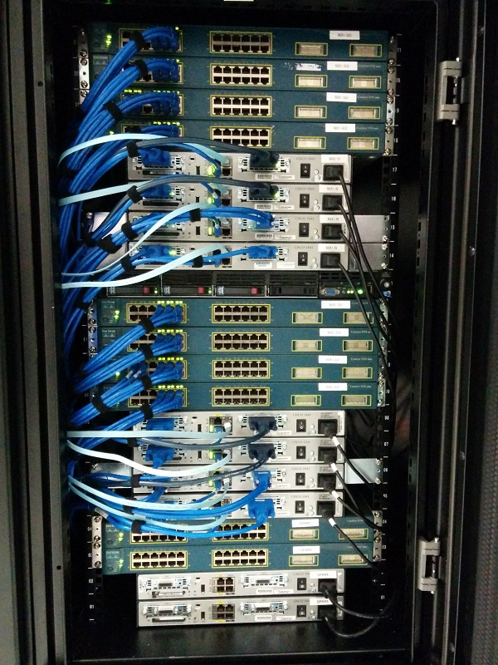
Rack and patch pannel

